Slide 1
Chapter 25
Halliday & Resnick’s
Fundamentals of Physics
Jearl Walker
Capacitance

Slide 2
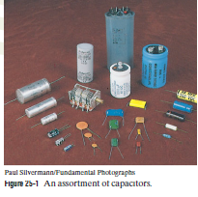


Slide 3
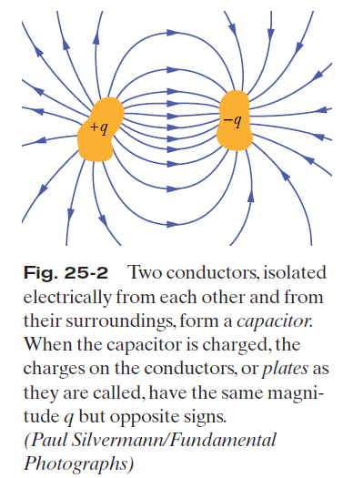
25.2: Capacitance:

Slide 4
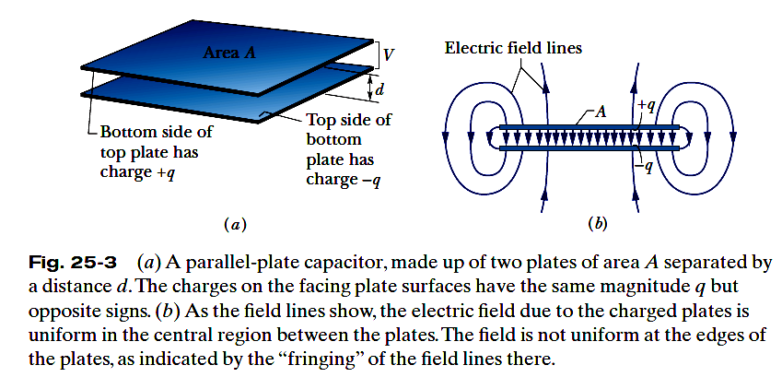

25.2: Capacitance:
When a capacitor is charged, its plates have charges of equal magnitudes but opposite signs: q+ and q-. However, we refer to the charge of a capacitor as being q, the absolute value of these charges on the plates.
The charge q and the potential difference V for a capacitor are proportional to each other:
The proportionality constant C is called the capacitance of the capacitor. Its value depends only on the geometry of the plates and not on their charge or potential difference.
The SI unit is called the farad (F): 1 farad (1 F)= 1 coulomb per volt =1 C/V.

Slide 5
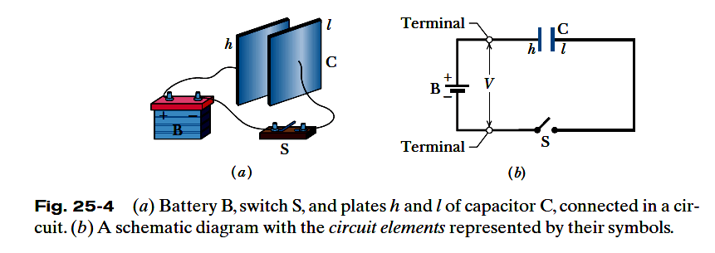
25.2: Charging a Capacitor:
The circuit shown is incomplete because switch S is open; that is, the switch does not electrically connect the wires attached to it. When the switch is closed, electrically connecting those wires, the
circuit is complete and charge can then flow through the switch and the wires.
As the plates become oppositely charged, that potential difference increases until it equals the potential difference V between the terminals of the battery. With the electric field zero, there is no further drive of electrons. The capacitor is then said to be fully charged, with a potential difference V and charge q.

Slide 6
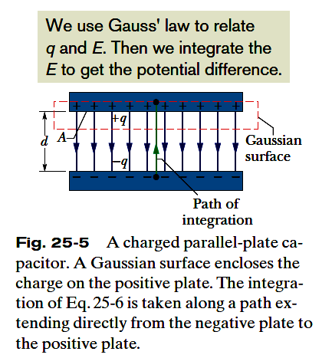








25.3: Calculating the Capacitance:
To relate the electric field E between the plates of a capacitor to the charge q on either plate, we use Gauss’ law:
Here q is the charge enclosed by a Gaussian surface and
is the net electric flux through that surface. In our special case in the figure,
in which A is the area of that part of the Gaussian surface through which there is a flux.
the potential difference between the plates of a capacitor is related to the field E by
If V is the difference V_{f} -V_{i} ,
Here,

Slide 7
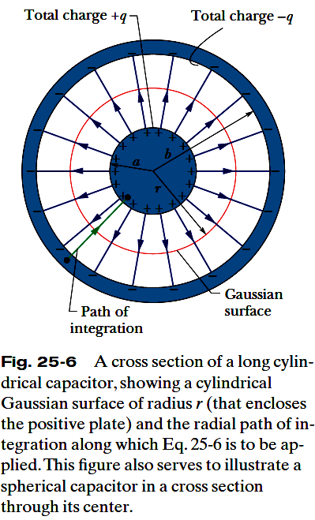




25.3: Calculating the Capacitance, A Cylindrical Capacitor :
As a Gaussian surface, we choose a cylinder of length L and radius r, closed by end caps and placed as is shown. It is coaxial with the cylinders and encloses the central cylinder and thus also the charge q on that cylinder.

Slide 8
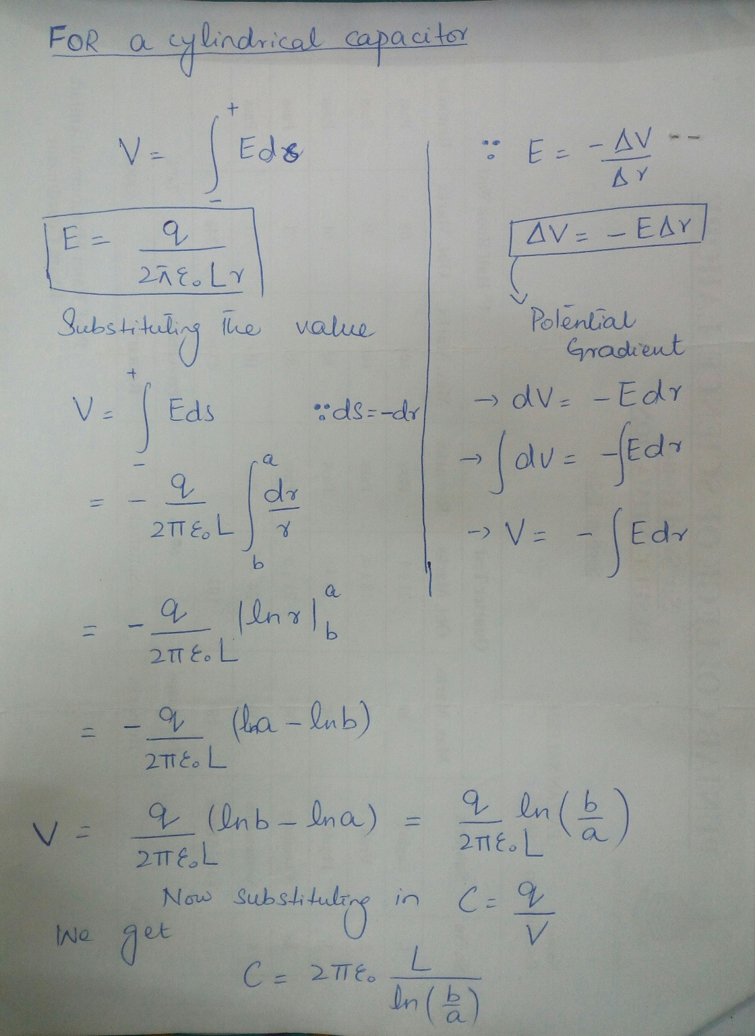

Slide 9



25.3: Calculating the Capacitance, A Spherical Capacitor:

Slide 10
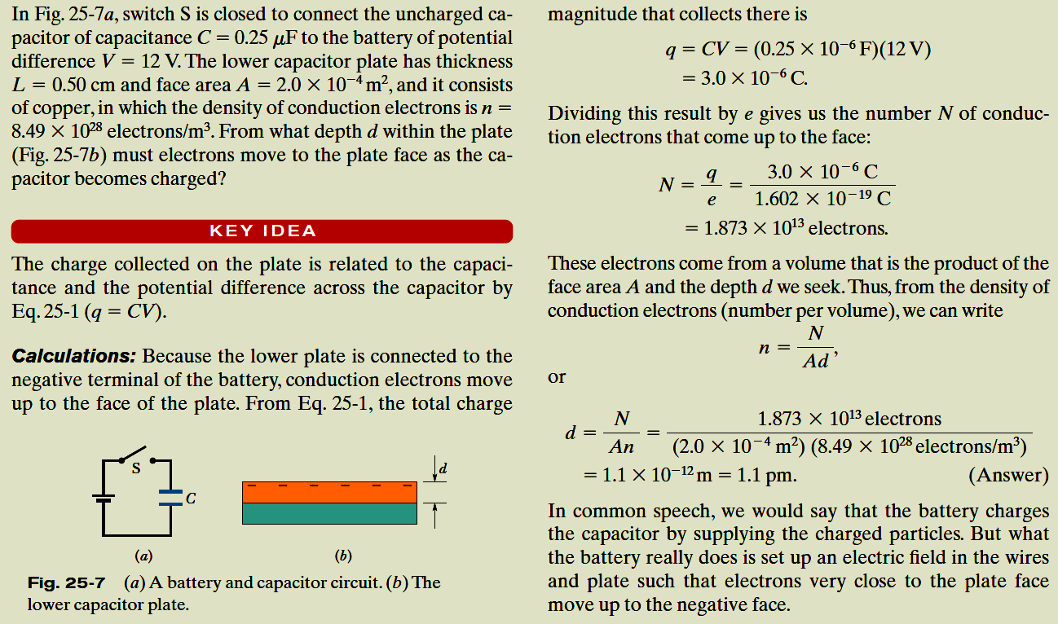
Example, Charging the Plates in a Parallel-Plate Capacitor:

Slide 11
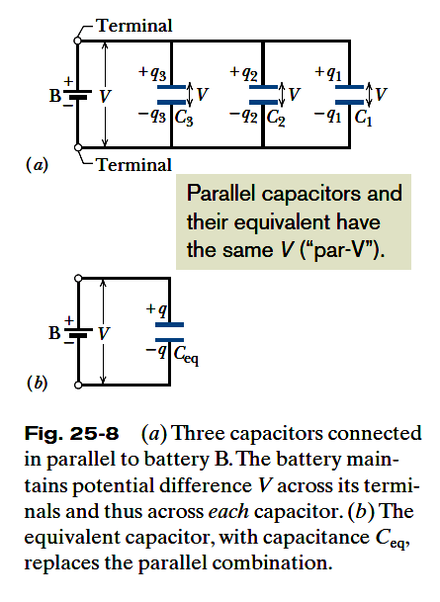


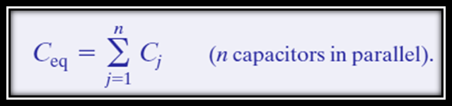
25.4: Capacitors in Parallel:
When a potential difference V is applied across several capacitors connected in parallel, that potential difference V is applied across each capacitor. The total charge q stored on the capacitors is the sum of the charges stored on all the capacitors.
Capacitors connected in parallel can be replaced with an equivalent capacitor that has the same total charge q and the same potential difference V as the actual
capacitors.

Slide 12
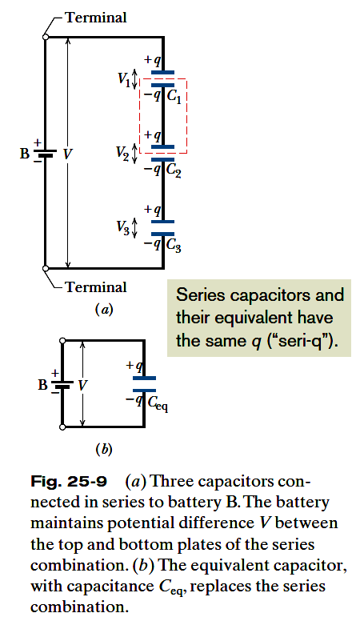




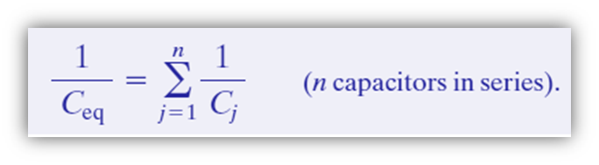
25.4: Capacitors in Series:
When a potential difference V is applied across several capacitors connected in series, the capacitors have identical charge q. The sum of the potential differences across all the capacitors is equal to the applied potential difference V.
Capacitors that are connected in series can be replaced with an equivalent capacitor that has the same charge q and the same total potential difference V as the actual series capacitors.

Slide 13
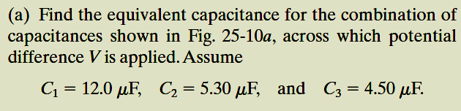
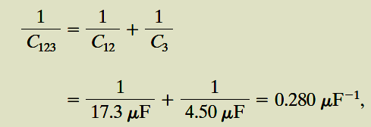

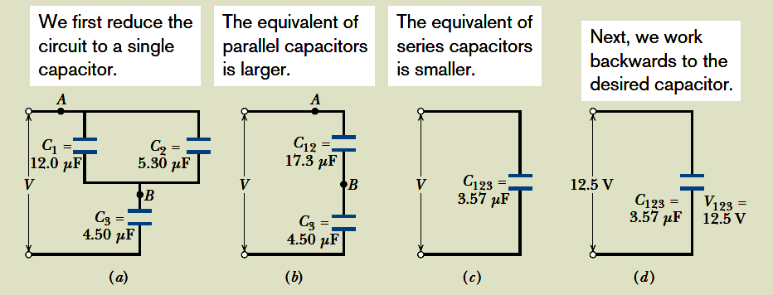

Example, Capacitors in Parallel and in Series:

Slide 14

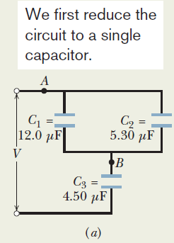
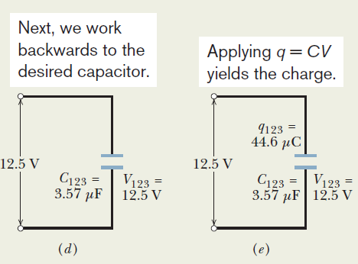


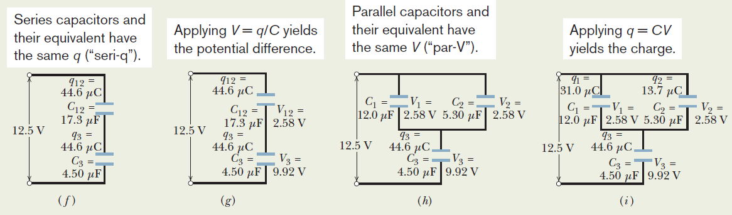
Example, Capacitors in Parallel and in Series:

Slide 15
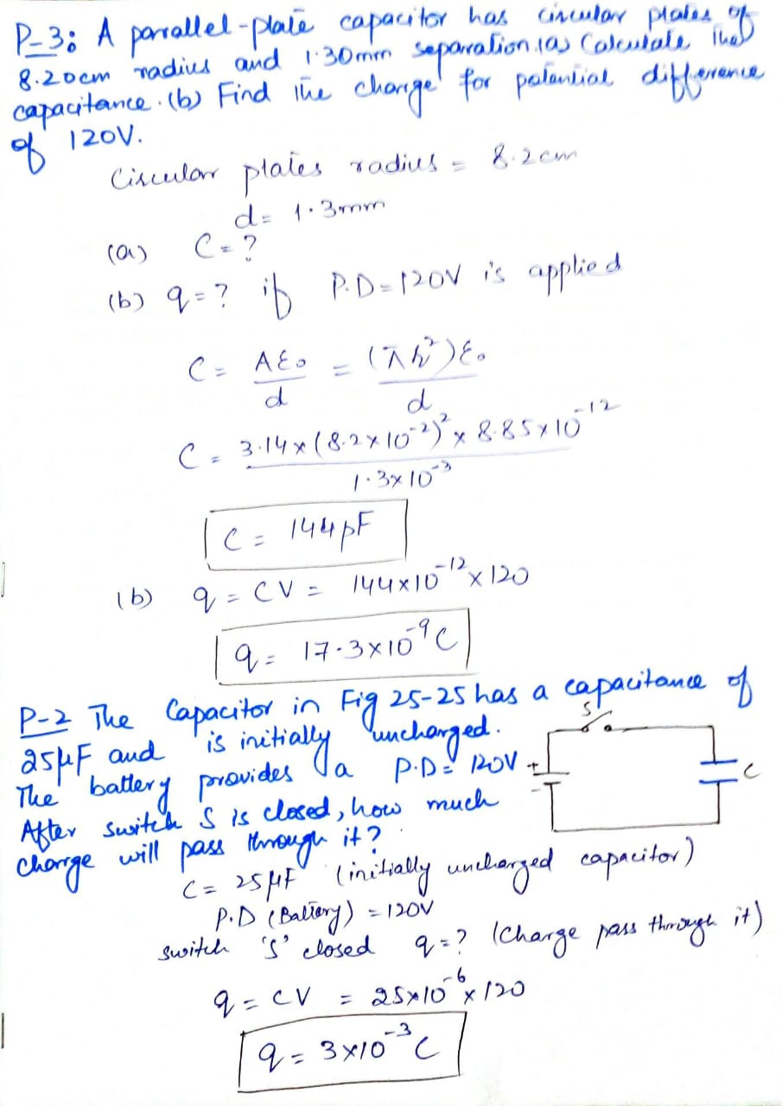

Slide 16
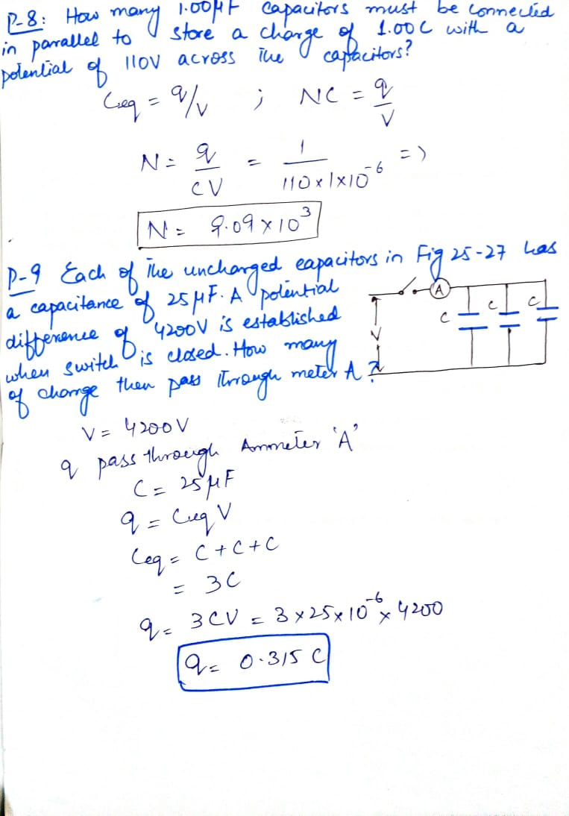

Slide 17
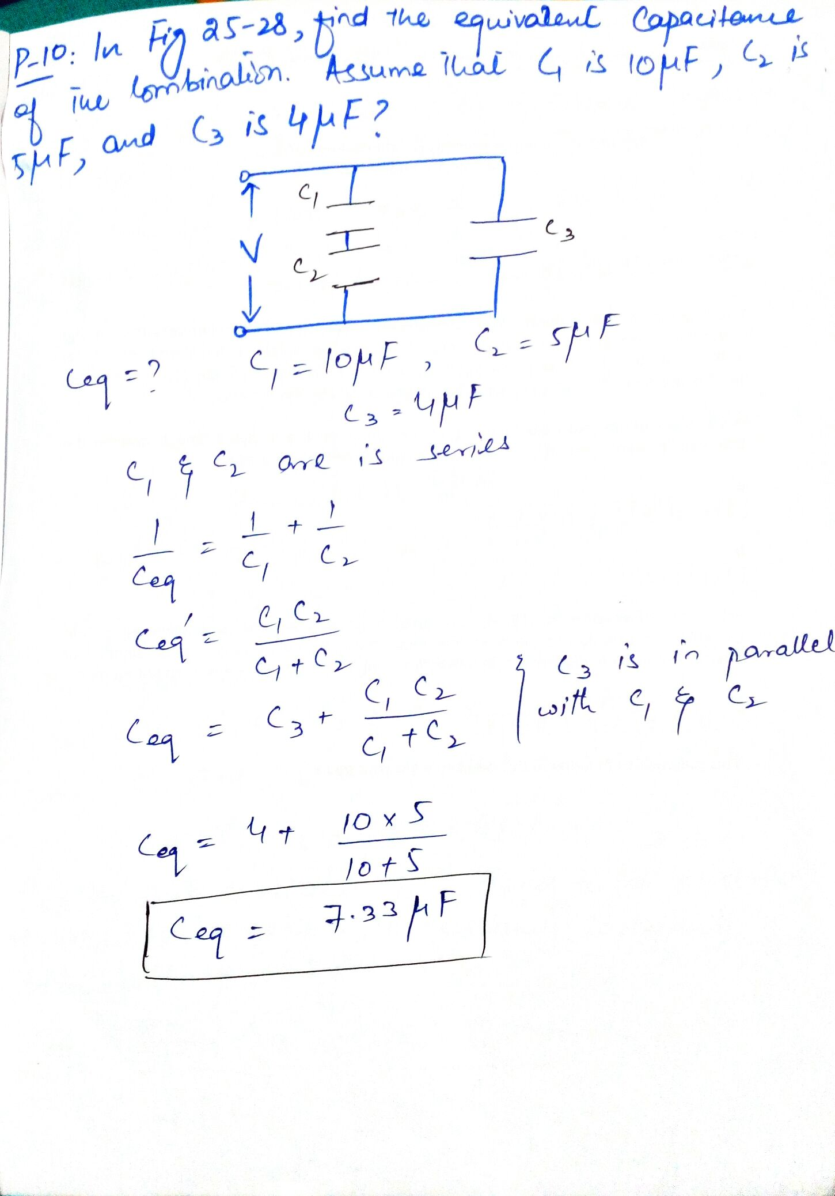

Slide 18
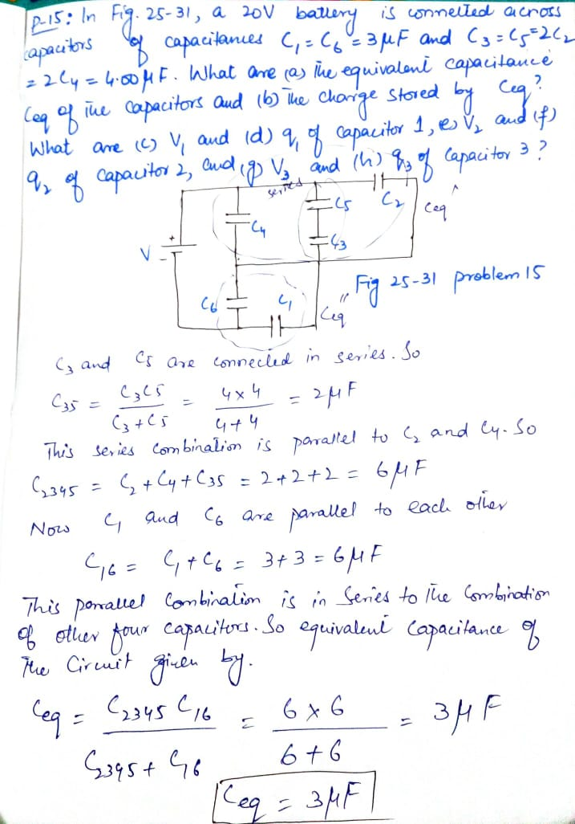

Slide 19
Chapter 25: Capacitance
Exercise problems: 1, 2, 3, 4, 6, 8, 9, 10, 11, 12, 13, 14, 15
Sample problems: 25.01, 25.02, 25.03

